Slide 1
6502 Block Diagrams & Small Details

Slide 2

System Block Diagram
Power Supply
ROM
Video
CPU
I/O
RAM
User Interface
Data Bus
Front Panel
(Optional – Not Completed)
Address Bus
Power

Slide 3
CPU Card Block Diagram
Address | Function
0X0000 | Page Zero Start
0X0100 | Stack Bottom
0X0200 | User Memory (RAM)
0XBFFF | 48K RAM Top
0XC000 | 4K RAM Start
0XCFFF | 4K RAM Top
0XD000 | Blank 4K Slot
0XE000 | I/O Board RAM (2K)
0XE800 | Video RAM (1K)
0XEC00 | GP I/O Space
0XEE00 | KBD I/O
0XEE01 | GP I/O slot 2
0XEE02 | GP I/O slot 3
0XEE03 | GP I/O slot 4
0XF000 | ROM Space
0XFFFA | NMI Lo Addr Vector
0XFFFB | NMI Hi Addr Vector
0XFFFC | Reset Lo Addr Vector
0XFFFD | Reset Hi Addr Vector
0XFFFE | IRQ/BRK Lo Addr Vector
0XFFFF | IRQ/BRK Hi Addr Vector
Clock
& Timing
CPU
(6502)
Address Bus Drivers
Address Bus (16)
Data Bus Drivers
Data Bus (8)
Memory Read
Control &
Status Signals
Address Decode Logic
Memory Write
I/O Read
I/O Write

Slide 4
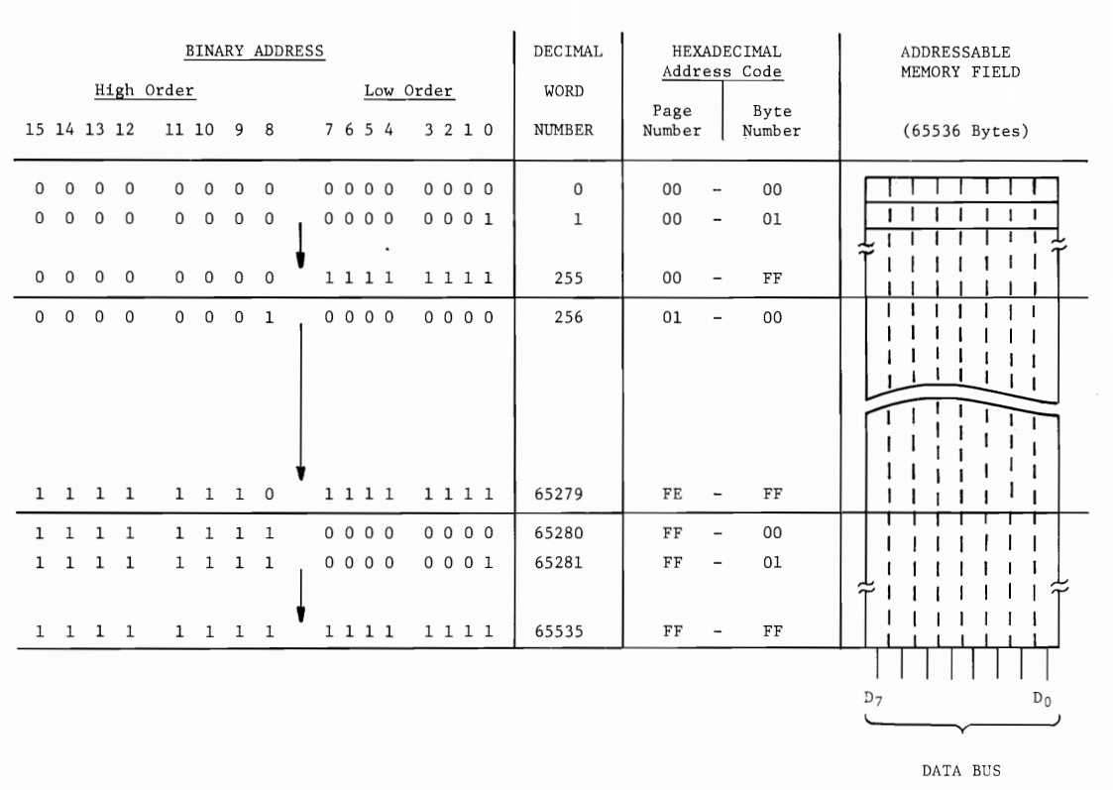

Slide 5
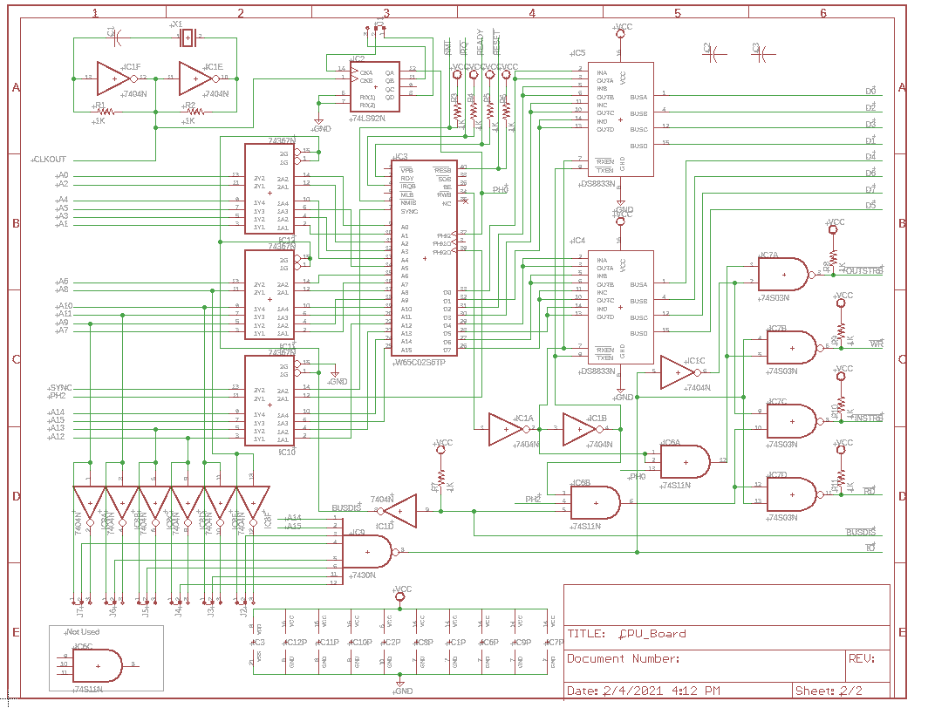
CPU Logic Decoding Address Blocks

Slide 6
RAM Board Block Diagram
Control & Timing From CPU
Address Decode Logic
16K X 8bit RAM
16K X 8bit RAM
16K X 8bit RAM
Dynamic Memory Timing
Address Bus (16)
Data Bus (8)

Slide 7
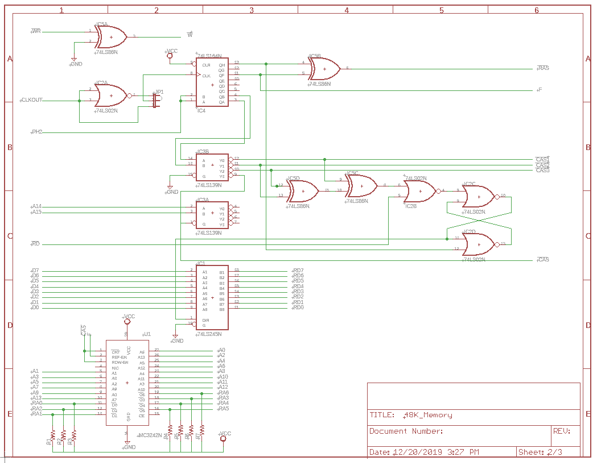
48K Dynamic Memory Board Logic

Slide 8
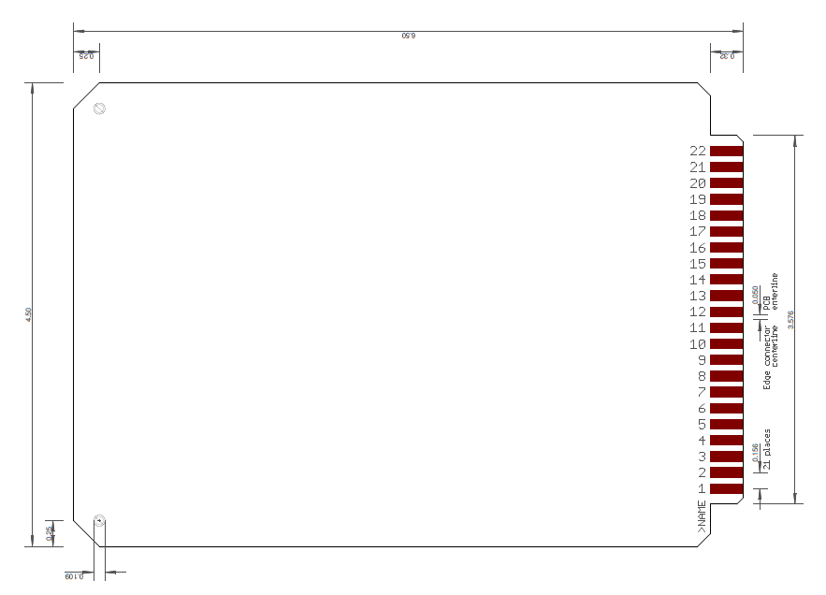
6502 Card Outline
6.51 (5)
0.366
(1)
0.55
NOTES:
No corners are chamfered on original boards
Fingers go most of the way to the end of the connector tab as shown but tab is 0.366 not 0.32 deep
All connector specific tab dimensions are correct as is connector shown in other PDFs. Connectors are 44 pin card edge, 22 contacts per side.
This dimension could grow by 0.25” and not impact card cage
This dimension could grow by 0.5” and not impact card cage
(2)
(3)
0.36 (4)

Slide 9
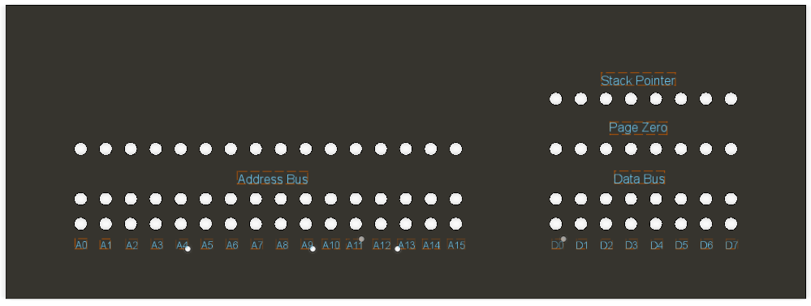
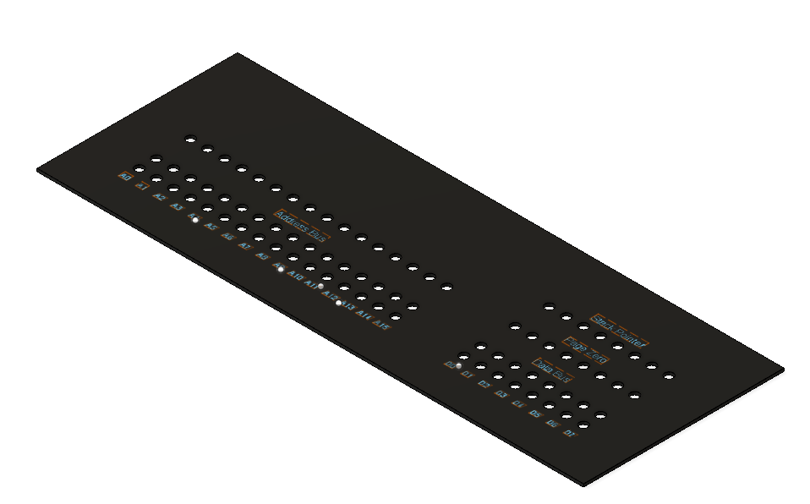
6502 Front Panel Concept

Slide 10
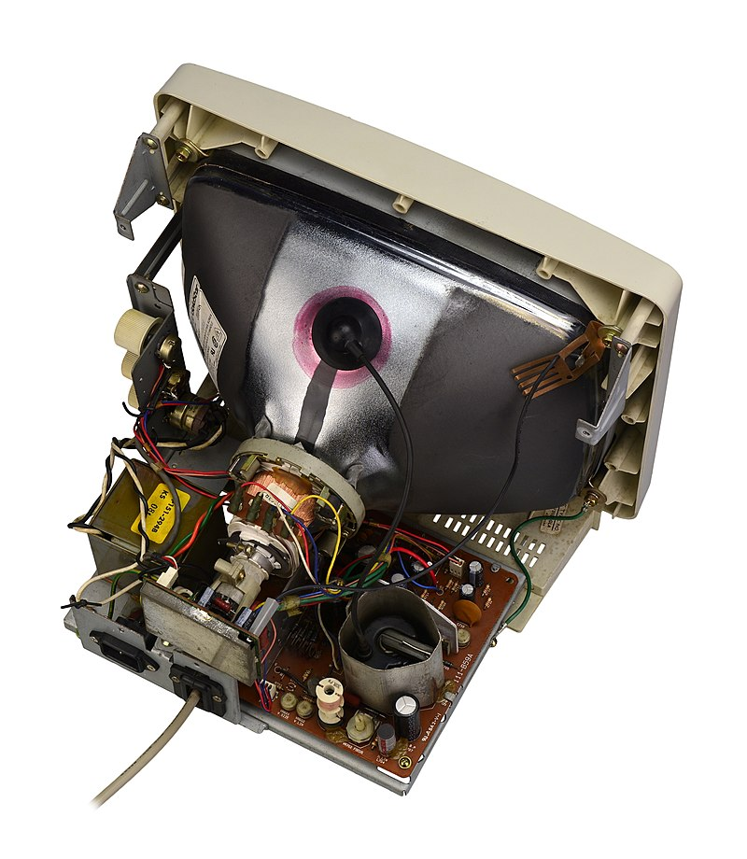
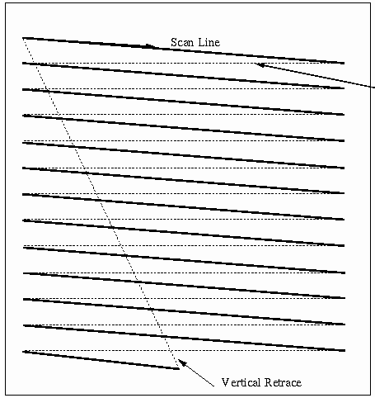
Monochrome Video Monitor
An electron beam sweeps from left to right, and is switched on and off to generate a horizontal pattern of dots. The beam is then turned off while it’s moved back to the left and down slightly for the next horizontal scan line of dots. After the bottom scan line is completed, the beam is returned to the top left of the screen and the process is repeated 30 times a second.

Slide 11
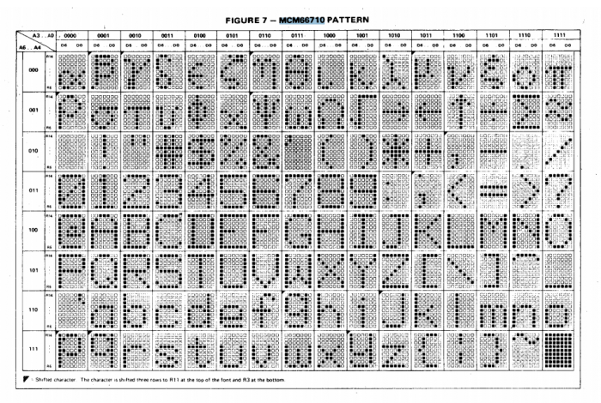
Video Display of Characters
The display consists of 16 lines of 64 characters per line. An 8-bit code is stored in 1024 consecutive video RAM locations ($E800 - $EBFF). The 7 x 9 dot pattern comprising each of 128 ASCII characters is read from a special purpose character generator ROM.

